Slide 1
Redundant, Obsolescent, and Deleted FORTRAN Features

Slide 2
Pre-FORTRAN 90 Character Restrictions
The character set for naming variables included
Uppercase A to Z and Digits 0 to 9
Lowercase were undefined in the standard but usually made equivalent to uppercase
Fortran names were restricted to a maximum of six characters.

Slide 3
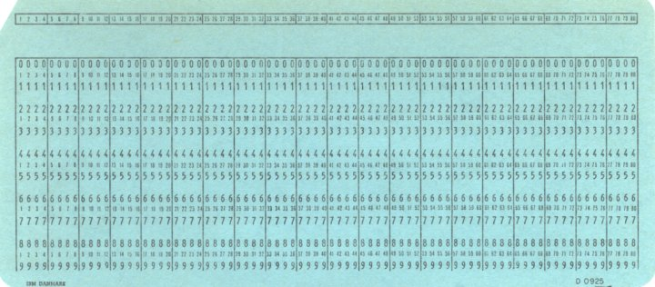
Obsolescent Source Form
Statement Label
Fortran instructions
Card ID Field
Col. 7 - Start of FORTRAN Statement
Col. 6 – Reserved for Continuation Statement
Col. 1 – Used for Comment Statement
Col. 72 - End of FORTRAN Statement
Declared Obsolescent in FORTRAN 95

Slide 4
Redundant Data Type
Before Fortran 90 there were two types of real variables:
REAL and DOUBLE PRECISION
The exact precision and range varied

Slide 5
Pre-Fortran 90 Specification Statements
The form of many specification statements was different.
Double colons (::) were not used.
Initialize variables in type declaration wasn’t possible.
Character length was declared:
Pre-Fortran 90 type specification statements:
CHARACTER*20 var, var2, var1*5
INTEGER list of integer variables
REAL list of real variables
DOUBLE PRECISION list of double precision variables
COMPLEX list of complex variables
LOGICAL list of logical variables
CHARACTER list of character variables
CHARACTER*<len> list of character variables

Slide 6
The IMPICIT Statement
By default, named constants and variables that begin with:
I through N are INTEGERS
All others are REAL
The IMPLICIT statement overrides this.
IMPICIT COMPLEX (a-c, i, z), DOUBLE PRECISION d
INTEGER i1, i2

Slide 7
The DIMENSION Statement
Used to declare the length of arrays
Has the general form:
Dimension declares the length of the array not its type.
DIMENSION array(i, j), …

Slide 8
The Data Statement
Before Fortran 90 it was not possible to initialize variables in a type declaration
Variables were initialized by a separate DATA statement.
The DATA statement has the form:
DATA variable names /values/, variable names /values/ …
Examples:
REAL a1(2,2)
DATA a1 /1., 2., 3., 4./ assigned in column order
DATA a1, b1, c1 /1., 2*0.0/
DATA ((a2(i,j), j=1,2), i=1,2) /1., 2., 3., 4./

Slide 9
The PARAMETER Statement
Introduced in Fortran 77
Used to declare parameters
Currently retained for backward compatibility
INTEGER SIZE
PARAMETER (Size = 1000)
In Fortran 90:
INTEGER, PARAMETER :: SIZE = 1000

Slide 10
Sharing Memory Locations
Fortran includes two statements that permit different variables to physically share the same memory locations
COMMON
EQUIVALENCE
Both have been replaced by better methods in Fortran 90 and later

Slide 11
The COMMON Statement
Before Fortran 90, information was shared among procedures through COMMON blocks.
A COMMON block is a declared region of memory that is accessible to every procedure containing the block:
A COMMON block could contained:
Any mixture of real, integer, and logical variables or
Character data but not both
This restriction was removed in Fortran 90
COMMON /name/ var1, var2, var3,…

Slide 12
More about COMMON Blocks
A procedure can have as many COMMON blocks as the programmer wishes
Each separate COMMON must have a unique name.
COMMON block names are global in scope
The size of arrays
May be declared in the COMMON block or
The type declaration statement, not both.
Fortran allocates all COMMON with the same name to the same region of memory
Data saved there by one procedure may be read and used by another.
COMMON bocks do not have to be the same length in every procedure

Slide 13
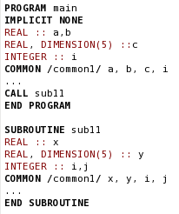
COMMON Block Example:

Slide 14



Potential Problems with COMMON Blocks
Proper use must ensure all variables:
Appear in the same order
Have the same type and size
It’s a good programming practice to keep the same names for each variable in every procedure.

Slide 15
The BLOCK Data Subprogram
The DATA statement may not be used in a main program or procedure to initialize variables in COMMON
A BLOCK DATA subprogram
Is the one place where variables used in COMMON are initialized.
This subprogram:
Begins with the BLOCK DATA statement
Can contain any number of type definition, COMMON, and DATA statements
May not contain any executable statements
BLOCK DATA initial
INTEGER ival1, ival2
COMMON /mydata/ ival1, ival2
DATA ival1, ival2 /1,2/
END BLOCK DATA

Slide 16
The Unlabeled COMMON Statement
A single unnamed COMMON block may be used in a program
It behaves just like a named COMMON except it has no name.

Slide 17
The EQUIVALENCE Statement
A common practice was to reuse portions of memory for scratch calculations in different procedures.
EQUIVALENCE is a mechanism used to assign two or more variables to the same memory location.
Every variable appearing within the parenthesis is assigned to the same memory location
The statement must appear in the declaration section,
After the type declarations and
Before the DATA statements
EQUIVALENCE (var1, var2, …)

Slide 18
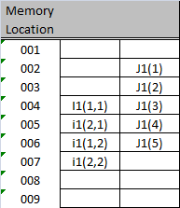
Arrays and EQUIVALENCE
Using EQUIVALENCE with Array elements fixes the relative relationship of all elements within both arrays
EQUIVALENCE (i1(2,1), J1(4))

Slide 19
Undesirable Subprogram Features
Alternate Subroutine Returns
Alternate Entry Points
The statement function
Passing intrinsic functions as arguments

Slide 20
Alternate Subroutine Returns
These are statement labels passed as calling arguments used to decide where to return control once the subroutine completes.
Alternate Returns are specified in the follow manner:
The statement labels (proceeded by an *) used with all possible returns are specified in the CALL statement:
The alternate returns are specified in the SUBROUTINE statement by an *:
The particular statement that the subroutine returns to is specified on the RETURN statement:
Where k is the position of the alternate return to executed. (k values in this example are 100 and 200)
CALL sub(a, b, *100, *200)
SUBROUTINE sub(x, y, *, *)
RETURN k

Slide 21
Alternate Entry Points
It is possible to start execution at different point in a procedure using the ENTRY statement.
The ENTRY statement has the form:
A common use occurred when a subprogram need to be initialized the first time but not thereafter.
ENTRY name (arg1, arg2, …)

Slide 22
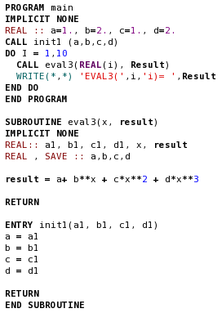
Alternate ENTRY point Example:

Slide 23
The Statement Function
Chapter 7 introduced external functions:
Returns a single value
Input values passed via an argument list
Invoked by being named in an expression
Chapter 9 introduced internal functions:
Similar to external functions except:
Entirely contain within another program unit
May only be invoked in that program unit
A third type of function is the statement function
Consists of a single statement
Must be defined in the declaration section
Calling arguments must be variables, constants or array elements.
Not possible to pass whole arrays

Slide 24
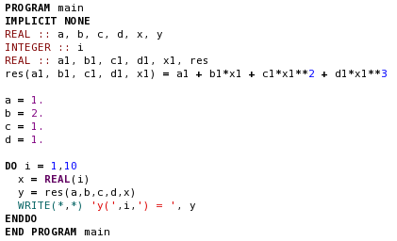
Statement Function Example:

Slide 25
Passing Intrinsic Functions as Arguments
It is possible to pass a specific intrinsic function as a calling argument
A pointer to that function is passed to the procedure
If the corresponding dummy argument is used as a function, then the intrinsic function is used in its place.
GENERIC intrinsic functions may not be used.
A specific intrinsic function must be declared in an INTRINSIC statement before it can be passed.
Statement must appear in the declaration section
Used by the compiler to distinguish the difference between a variable and a function of the same type
INTRINSIC name1, name2, …

Slide 26
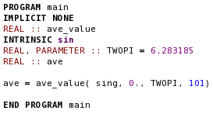
Intrinsic Function Passing Example:
Sin,

Slide 27
The PAUSE Statement
Used to pause a program at certain points while a user examines the results displayed on a screen.
The general form:
Where the prompt is an optional value to be displayed when PAUSE is executed
Same function is possible with WRITE and READ statements with more flexibility
Has been deleted form the Fortran Standard.
PAUSE prompt

Slide 28
STOP Statement Arguments
The STOP statement can also include an argument
The general form is :
Where the stop_value is an optional value displayed when the STOP is executed.
Useful in identifying which STOP statement executed when a program has multiple STOPs.
STOP stop_value

Slide 29
The END Statement
Prior to Fortran 90 all program units terminated with an END statement instead of a END PROGRAM, END SUBROUTINE, etc.
For backward compatibility END is still accepted.
Internal procedures and module procedures must end with an END SUBROUTINE or END FUNCTION statement.

Slide 30
The Arithmetic IF Statement
IF (arithmetic_expression) label1, label2, label3
If the arithmetic_expression is
Negative, control pass to statement label1
Zero, control passed to statement label2
Positive, control passed to statement label3
Very old, dates back to the origins of Fortran in 1954.

Slide 31
The Unconditional GOTO Statement
The GOTO statement has the form:
Where label is the label (or name) of an executable statement.
When executed control jumps unconditionally to the statement with the specified label.
GOTO was often combined with IF statements to create loops and conditional branches.
Excess use of the GOTO promotes spaghetti code.
GO TO label

Slide 32
The Computed GO TO Statement
GO TO (label-1, label-2, …, label-k) int_expr
Label-1 thru label-k are statement labels of executable Fortran statements
The int_expr is a integer expression that yields a value of 1 thru k
When the expression value is equal to the position number of a label the control is transferred to the statement at that label.

Slide 33
The Assigned GO TO Statement
There are two forms of this statement:
Before this statement is executed a statement label must be assigned to int_var using the ASSIGN statement:
In the first form -
The int_var contains the statement number of the statement to be executed next.
The program checks the value of int_var against the label list
If it matches then control is transferred to that statement
If no match then an error occurs
The second form
No error checking is performed
Control is transferred to the label in int_var provided its valid
Otherwise Control transfer to the next statement after the GO TO.
GO TO int_var (label-1, label-2, …)
And
GO TO int_var
ASSIGN label TO int_var

Slide 34
Older Forms of DO Loops
Early DO Loops had the structure:
Example:
Many programmers developed the habit of ending DO loops with the CONTINUE statement:
DO 100 I = istart, iend, incr
…
100 …
DO 100 I = 1, 100
a(i) = b
100 b = b + 1
DO 100 I = 1, 100
a(i) = b
b = b + 1
100 CONTINUE

Slide 35
DO Loops in Fortran 77
The Fortran 77 standard allow the use of single and double precision real numbers to be used as DO loop indicies
This was a bad decision since the behavior of the DO loops with real indices varied from processor to processor.
This feature has been deleted in Fortran 95

Slide 36
Good Coding Practice
None of the features described here should be used in any new Fortran programs. With the possible exception of the STOP statement

